Slide 1
Cricket Analysis Using POWERBI
cricket ANALYSIS
Group Members:
PD 09: Arishi Gupta
PD 10: Tanvi Kulkarni
PD 11: Advait Kulkarni
PD 28: Pranav Bapat

Slide 2
Max of runs by batsman and venue
Max of runs by batsman AGAINST A BOWLER
01
02
METHODOLOGIES
OUR TEAM
03
04
Cricket analysis
Maximum of runs scored by a batsman according to a venue
Maximum of runs scored by a batsman against a particular bowler
You can describe the topic of the section here
You can describe the topic of the section here

Slide 3
Max of runs by batsman and venue
Data ANALYSIS
This statistic combines the maximum of runs scored by a batsman across multiple venues in World Cricket.
The same is depicted in PowerBI using a stacked bar chart where
A. Y axis - batsman
B. X axis - Max of runs (Summarization - Maximum)
C. Legend - venue
Filtering can be performed for the above statistic by searching for a particular batsman or a particular venue.

Slide 4
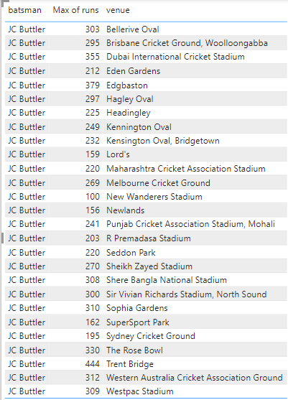
The table format used for the statistic
Data ANALYSIS
Following are the columns used in this table -
Batsman - (JC Butler in this case)
Max of Runs
Venue

Slide 5
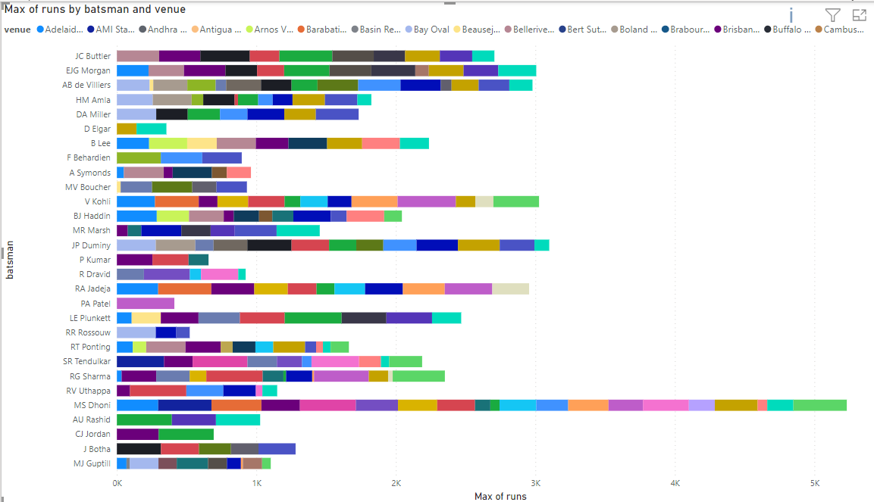
Results of the statistic
Data ANALYSIS

Slide 6
Findings from the statistic
Data ANALYSIS
This is a batsman oriented statistic.
It will help as a filter for the selection committee while selecting players in the playing XI across venues.
To quote an example,
Let us consider the first two batsman in the chart i.e. JC Butler and EJG Morgan respectively. Consider the venue - Kensington Oval, Bridgetown.
Runs scored by Butler - 232.
Runs scored by Morgan - 249.
As we can see, Morgan has got an edge over Butler and will make the playing XI first.

Slide 7
Max of runs by batsman aGAINST EVERY BOWLER
Data ANALYSIS
This graph gives us insights of the maximum of runs scored by a batsman against a particular bowler
The same is depicted in PowerBI using a stacked bar chart where
A. Y axis - batsman
B. X axis - Max of runs (Summarization - Maximum)
C. Legend - bowler

Slide 8
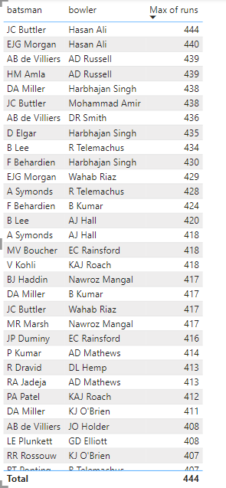
The table format used for the ANALYSIS
Data ANALYSIS
Following are the columns used in this table -
Batsman
Bowler
Max of runs

Slide 9
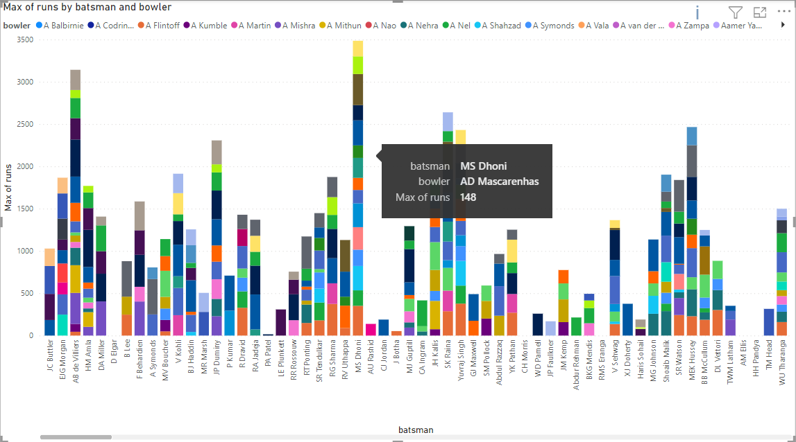
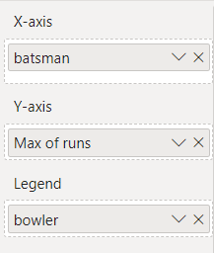
Results of the statistic
Data ANALYSIS

Slide 10
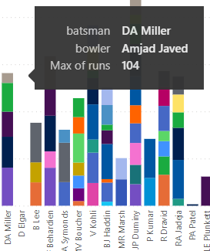
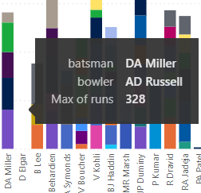
Findings from the statistic
Data ANALYSIS
This is a batsman oriented statistic.
It will help a particular batsman to analyse his own performance against different bowlers.
It will also give selectors an idea of which batsman can play well against which type of bowler.

Slide 11
Avg of runs score by wickets for a batting team
Data ANALYSIS
This graph provides us the average runs scored at fall of wickets for each team
The same is depicted in PowerBI using a stacked bar chart where
A. Y axis - Wickets
B. X axis - Runs (Average)
C. Small Multiples (bat_team)

Slide 12
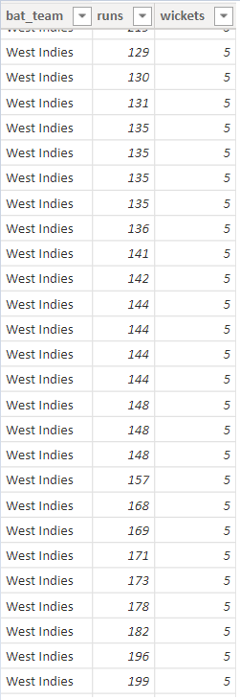
The table format used for the ANALYSIS
Data ANALYSIS
Following are the columns used in this table -
Batting Team
Runs
Wickets fall

Slide 13
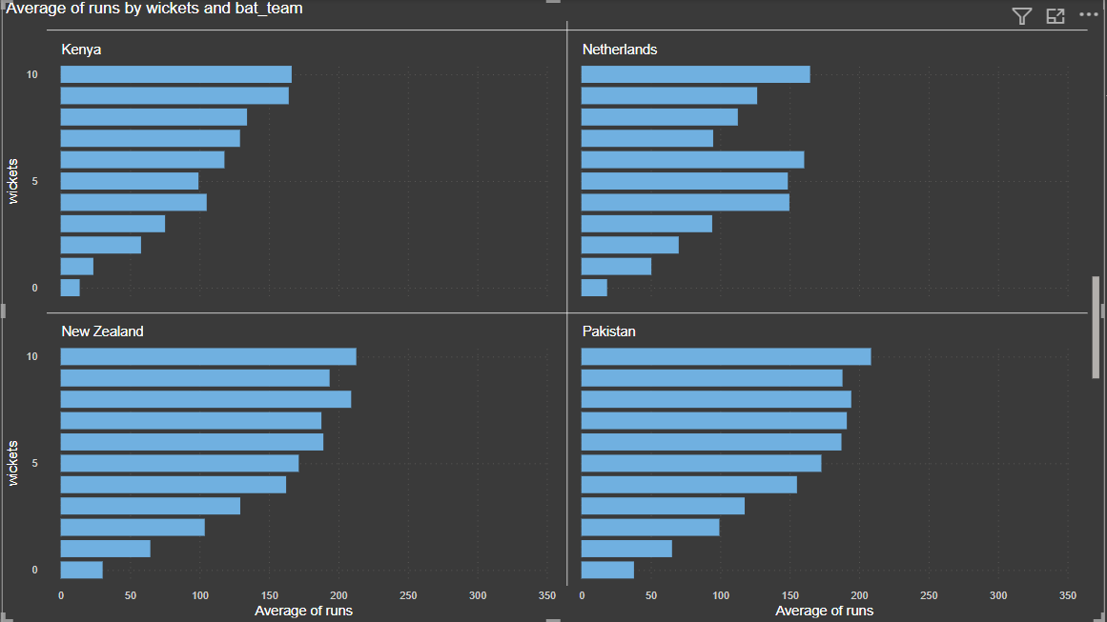
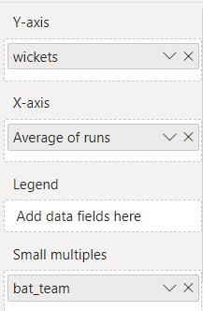

Slide 14
Findings from the statistic
Data ANALYSIS
This can be used to detect which order of batting is performing poorly. e g openiners, middle order, tailenders etc.
The decreasing difference between each bar for most teams as wickets increase tell us about skill of batsmen involved
If bar values show similar values for a few wickets, it mensa the batsmen in that position are weak and do not perform good partnerships.
Team specific-
South Africa- very weak middle order compared to earlier batsmen
Sri Lanka- Like to lose wickets quickly after 6 wickets
Ireland- Consistent batting performance shown

Slide 15
Max of RUNS BY BATTING TEAM AND bowling team
MENU
ANALYSIS
CONTACT
This statistic portrays maximum number of runs scored by the batting team against the bowling team.
In
The same is depicted using stacked column chart in the software PowerBI from Microsoft.
In the chart:
On X Axis: Batting Team
On Y Axis: Maximum of Number of Runs
Legend: Bowling Team
Filtering can be performed for the above statistic by searching for a batting team as well as a bowling team.

Slide 16
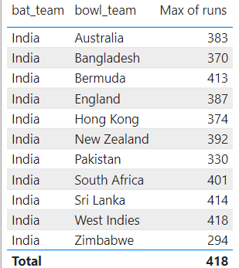
MENU
ANALYSIS
CONTACT
Data ANALYSIS
THE TABLE FORMAT USED FOR THIS STATISTIC
Following are the tables used in this analysis:
Batting Team: India, in this example.
Bowling Teams: Australia, Bangladesh, England, Pakistan can be seen among others.
Maximum of the runs scored by India against different bowling teams.

Slide 17
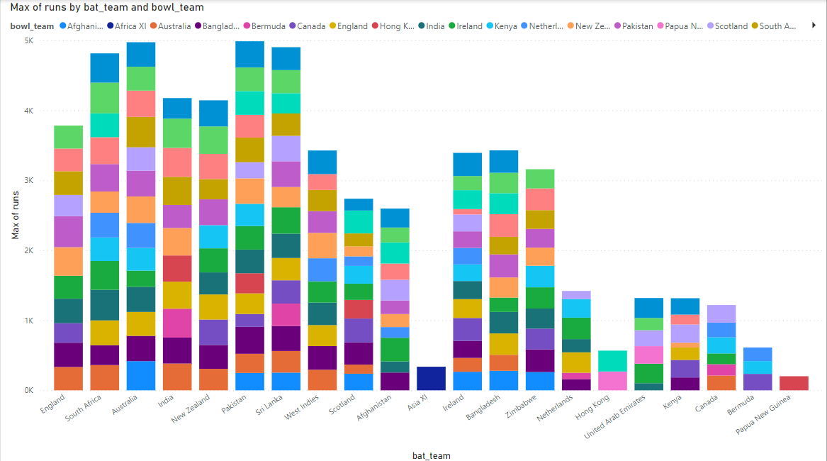
RESULTS OF THE STATISTIC ANALYSIS
MENU
ANALYSIS
CONTACT
Data ANALYSIS

Slide 18
MENU
ANALYSIS
CONTACT
Data ANALYSIS
FINDINGS FROM THE STATISTIC
This statistic can be beneficial to both the bowling team and the batting team to improve their performance.
We can figure out the teams that are stronger than the others by seeing the number of runs they score against them.
Teams can use this statistic to devise their strategy to win a match against the particular team.

Slide 19
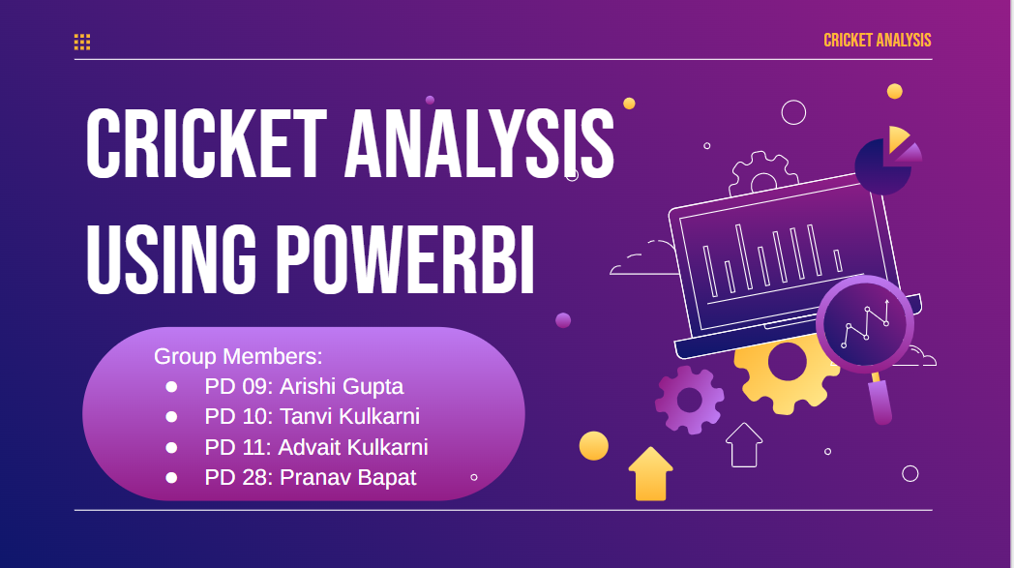
THANK YOU
MENU
ANALYSIS
CONTACT
Data ANALYSIS

